Slide 1
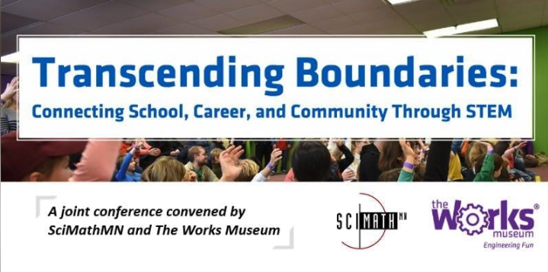
Teaching Computer Science (and AI) with Low-Cost Robots
Dan McCreary, CoderDojo

Slide 2
Teaching Computer Science with Low-Cost Robots
Room 155 Afternoon Session 2 | 2:30 - 3:30 p.m.
Dan McCreary, CoderDojo Twin Cities
Over a three-year period, a team at CoderDojo Twin Cities designed and tested a $25 Arduino robot that can be used to engage both beginning and advanced students in fun and learning of more than 20 computer science concepts through a variety of hands-on labs. Participants will have a chance to experience this robot, learn how AI concepts can be taught using Raspberry Pi, discover available resources, and consider how to integrate these materials into their classrooms or programs.

Slide 3
Key Questions
What is CoderDojo?
What are Concept Cards? How are they used at CoderDojo events?
How can we leverage inexpensive hardware (Arduino and Pi)?
What exactly is AI and how is it different?
How will AI impact STEM education?
How will we teach AI concepts in our schools, colleges and universities?
Case Studies
Google’s Teachable Machine
The DonkeyCar Movement
Learning Recommendation Systems: Knowledge Spaces
The Futurists Academy
How will we Training our Teachers?
What are the key take-home points?

Slide 4
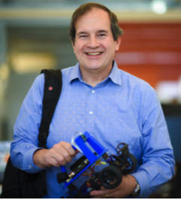
Hello, my name is
Dan
Distinguished Engineer at Optum Healthcare (50K technical staff)
Focused on AI and teaching AI
CoderDojo volunteer (5 years)
IoT Hackday – LED costumes
Cofounder of AI Racing League
Interested in teaching methodologies and learning content recommendation systems

Slide 5
Teaching Non-Programmers about AI
Hands-on activities for Optum product managers
Designed to get everyone comfortable with AI

Slide 6
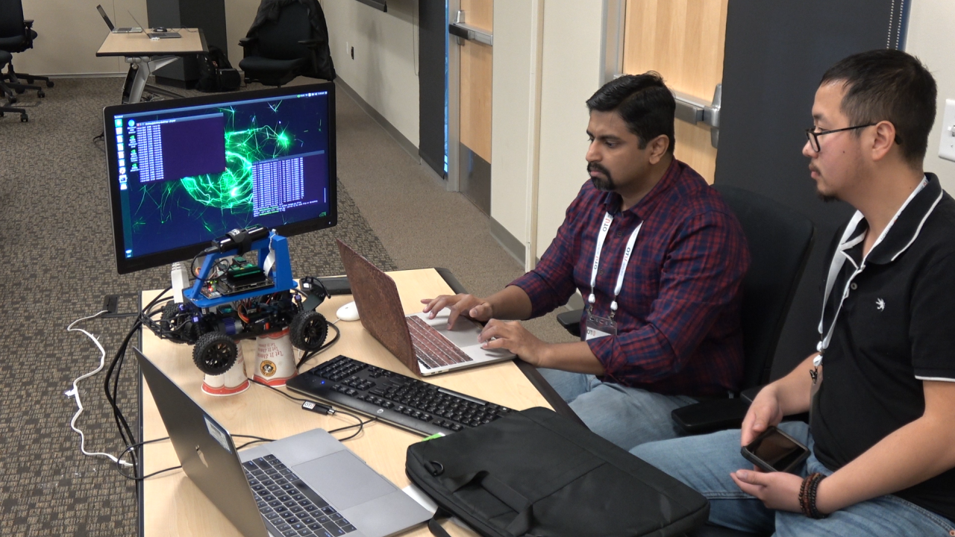
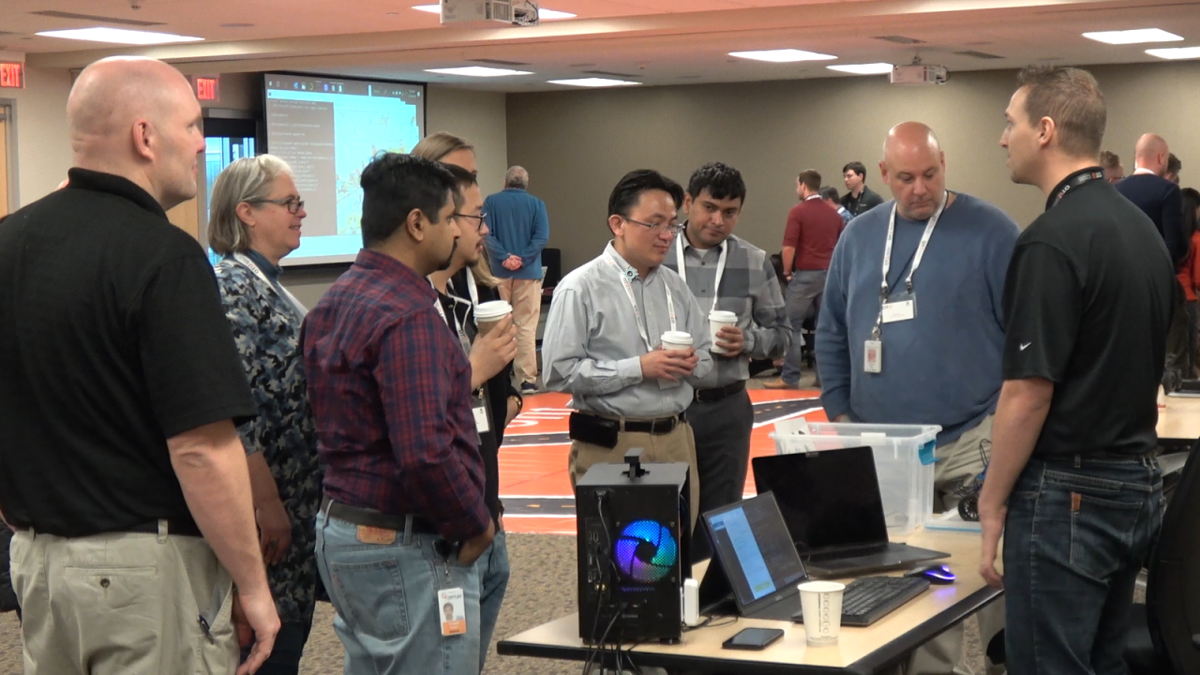
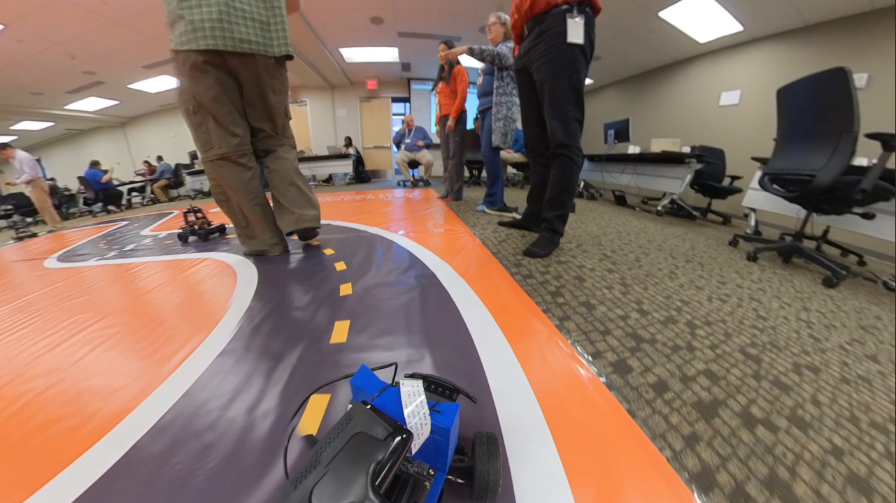
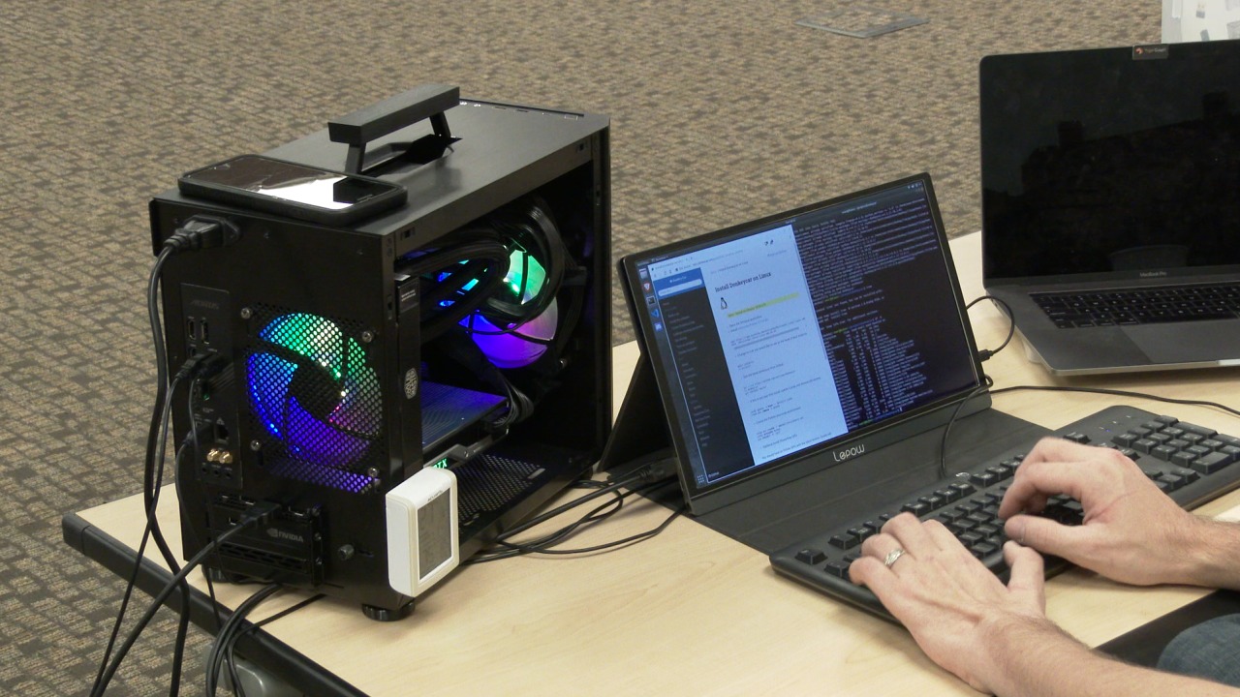
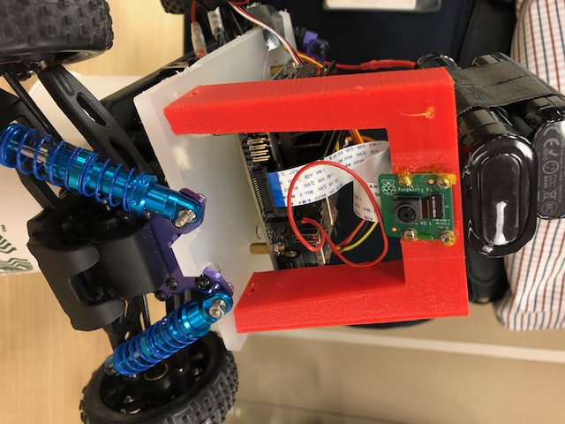
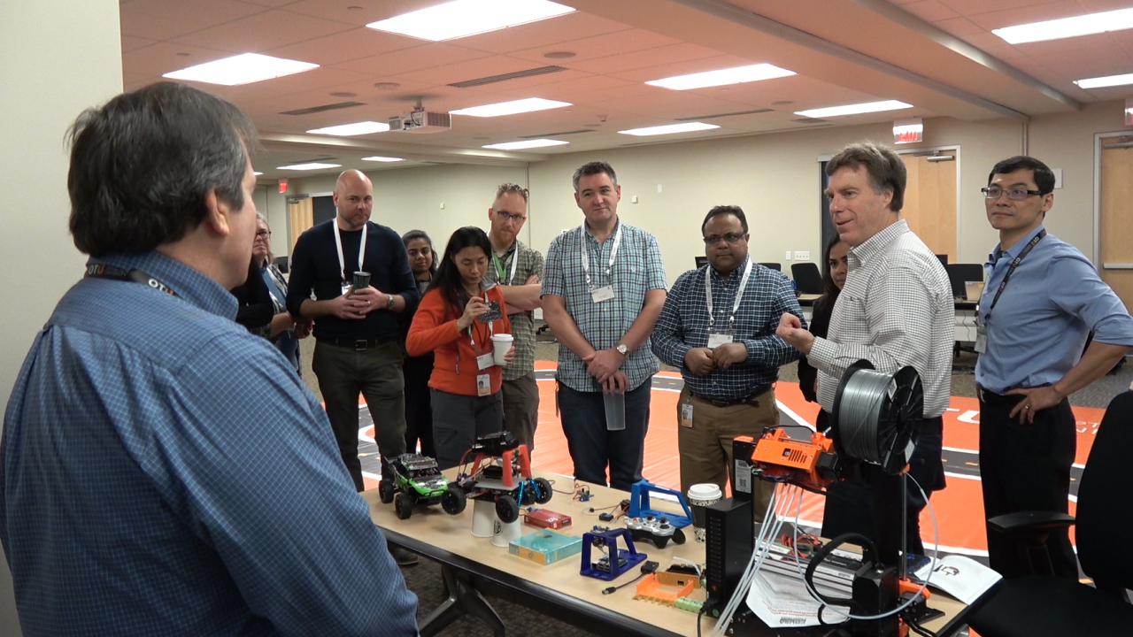
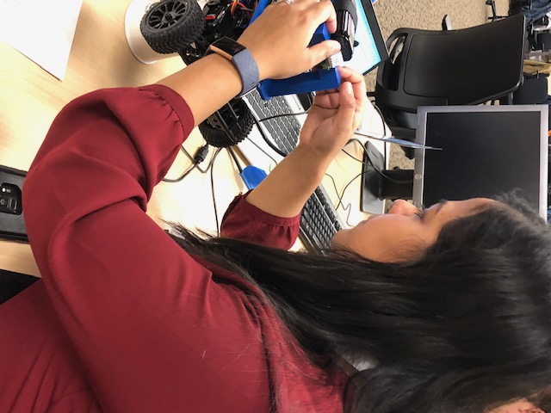
AI Racing
Teaching AI at Optum

Slide 7
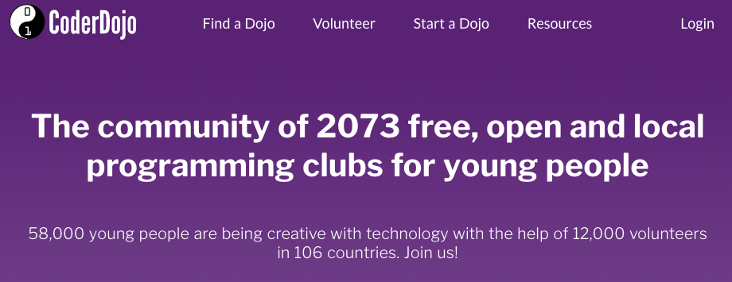
About CoderDojo
http://CoderDojo.org

Slide 8


About CoderDojo in Minnesota
Southwest (Uptown)
North Metro
St. Paul (3)
Northfield
Rochester
Worthington
One mentor for every 3 students
Project based learning
Encourage students to work in groups

Slide 9
CoderDojo TC
Over 100 events
Groups for
Scratch
Arduino
Python
Java
Unity Game Engine
App Inventor (mobile apps)
Robots
Note: Sign up window for non-volunteers is often around 10 minutes

Slide 10
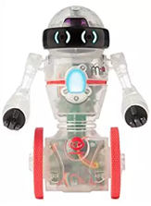
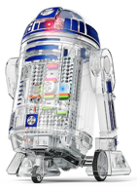
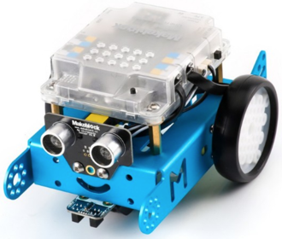
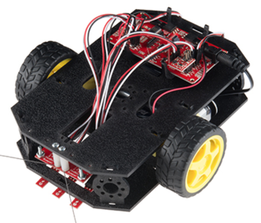
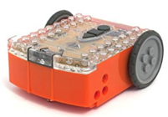
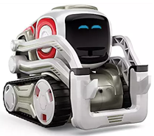
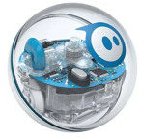
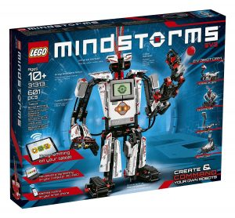
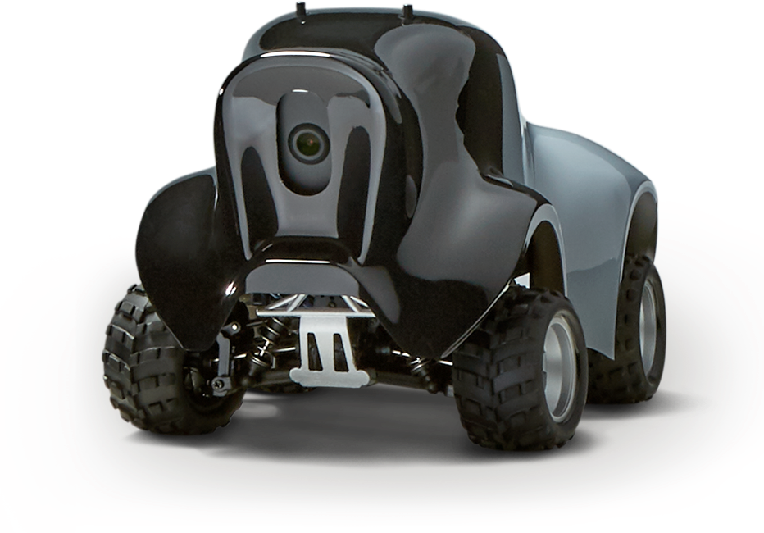
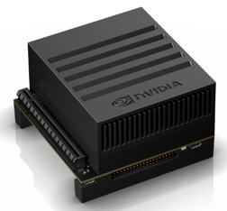
Many options
Droid Inventor
littleBits ($99)
SparkFun
Inventor Kit ($126)
Edison ($49)
Coder MIP ($49)
MBot ($79)
Cozmo ($129)
Sphero 2.0 ($179)
Lego Mindstorms
($349)
AWS DeepRacer ($499)
NIVIDIA Jetson Xaviar ($2,500)
($1,250)

Slide 11
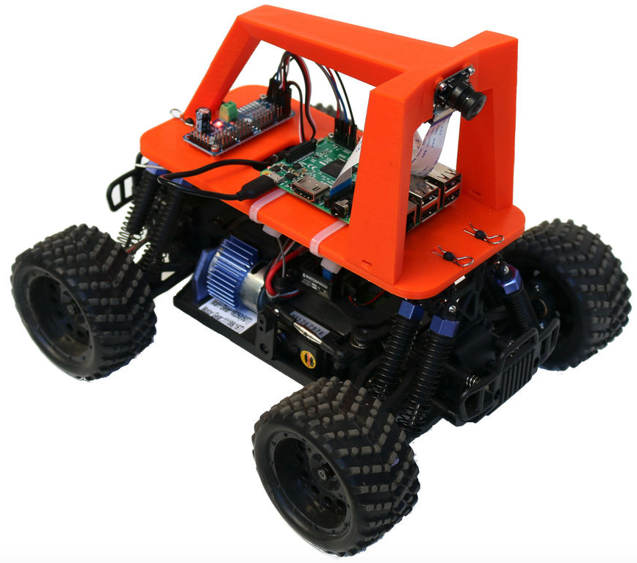
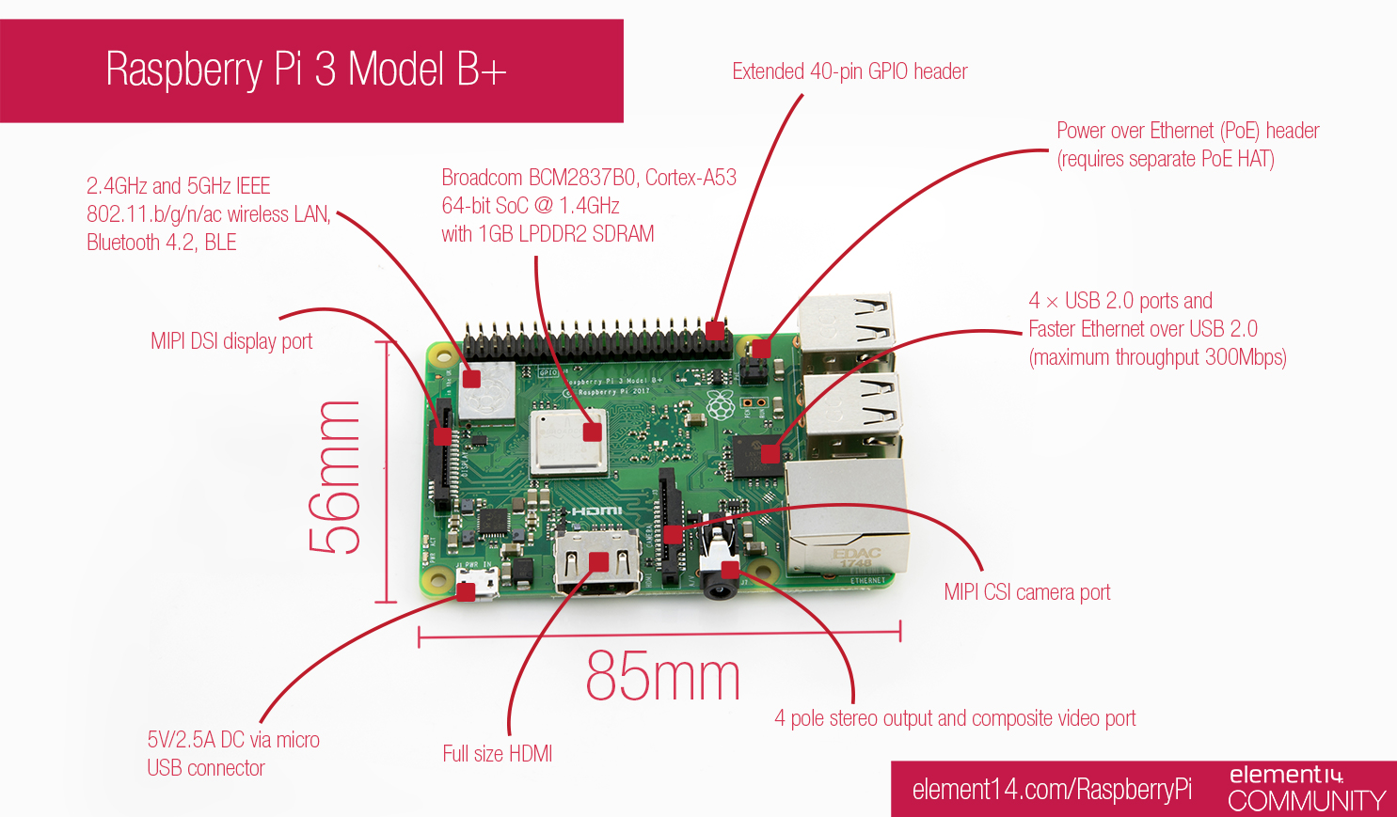
Donkey Car
Raspberry Pi
Activity: Go to the donkey car station and look at the sample Donkey Car. Ask a mentor to show you the parts.
Activity: Go to the Raspberry Pi station and see the Raspberry Pi 3+ board. Learn the names of the connectors. Ask the mentor some questions.
Questions
What are the key parts of the Donkey Car?
Notice how the front wheels turn.
Can you find an electric motor?
Can you find a battery? Are their multiple batteries?
Where is the Raspberry Pi (computer)?
Where is the camera? Is it on the front or back of the car?
What happens to the opposite wheel when you turn it?
How much does a Donkey Car cost?
Why do you think they call it a “Donkey Car”?
Questions
What is a a Raspberry Pi? How many types of Raspberry Pis are there?
Who created it and why?
What are the components of a Raspberry Pi?
How much does a typical Raspberry Pi B 3+ cost?
How much RAM does the Pi 3 B+ have?
How much storage (microSD) does it need?
How many different types of Raspberry Pis are there?

Slide 12
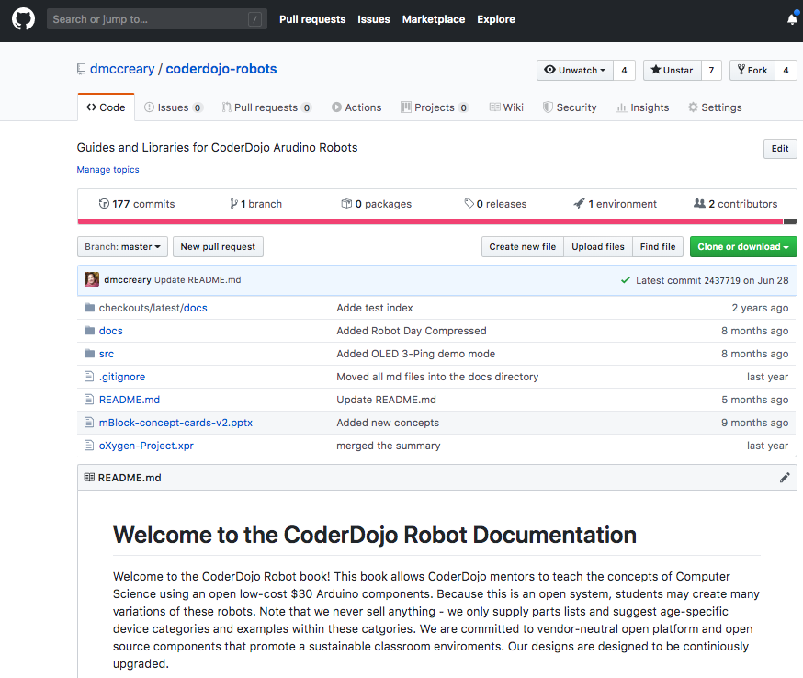
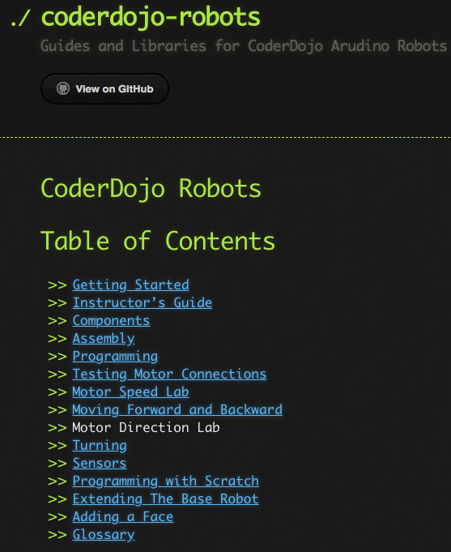
CoderDojo Robots – Open Source
https://github.com/dmccreary/coderdojo-robots
GitHub Pages Documentation

Slide 13
$25 Robot Platform for Teaching Programming
https://www.instructables.com/id/Collision-Avoidance-Robot-for-Teaching-Programming/

Slide 14
FaceBot - $40 with 64x128 OLED Screen
https://www.instructables.com/id/FaceBot/

Slide 15
Artificial Intelligence
Symbolic
Reasoning
Machine Learning
Knowledge Representation
How can we introduce machine learning concepts to students?

Slide 16
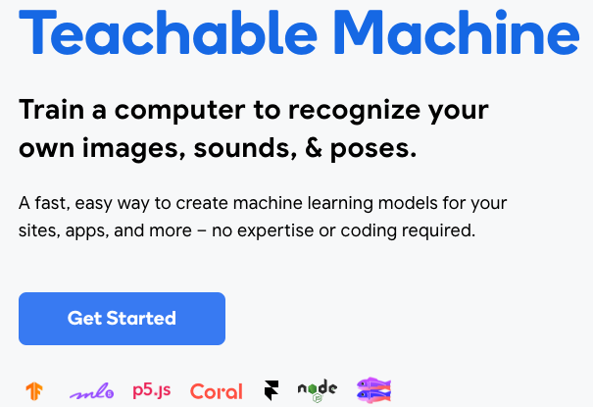
Google’s Teachable Machine
https://teachablemachine.withgoogle.com/

Slide 17
Backstory on the DonkeyCar Movement
Started by innovators in the Bay Area in 2016
Started as a small group of six people and doubled each quarter
Branded as a “Donkey Car” because the car was considered “ugly” by design
Now over 100 “DonkeyCar” clubs around the world
Some events have 250+ cars

Slide 18
Amazon November 2018 Announcement
https://venturebeat.com/2018/11/28/amazon-launches-autonomous-racing-league-and-399-deepracer-car/

Slide 19
Amazon Deep Racer
Large well funded project started by Amazon
Tied to AWS cloud-based training
Designed to teach AI concepts (Reinforcement Learning)
Originally a Closed System Shifting to more open system?
$399 retail list
Designed for colleges, makers and eventually high-school robotics

Slide 20
AI Racing League
The AI Racing League is a platform for AI education that integrates hands on learning using low-cost robots.
Cofounded with Jon Herke in March of 2019
First event in August of 2019 (soft launch)
Developing curriculum for high-school students

Slide 21
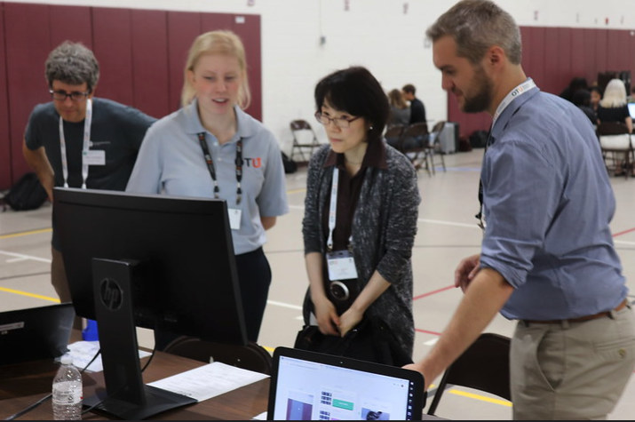

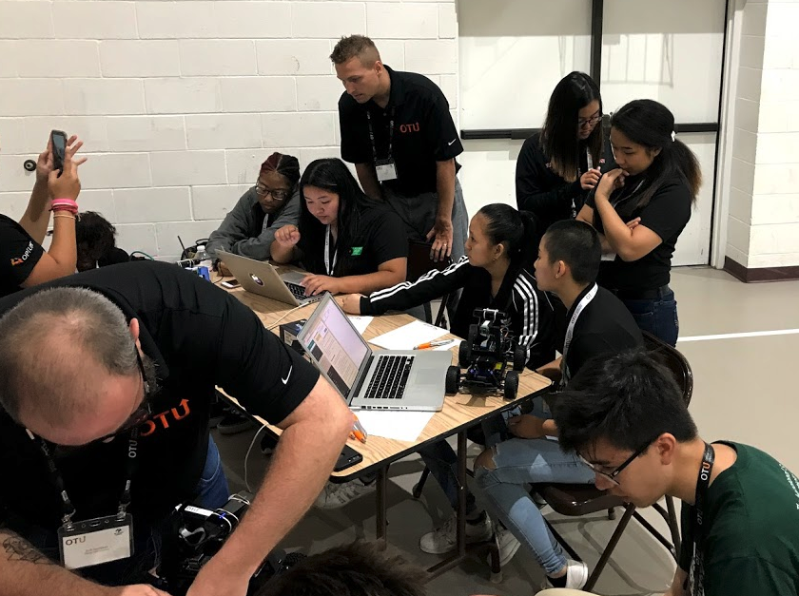
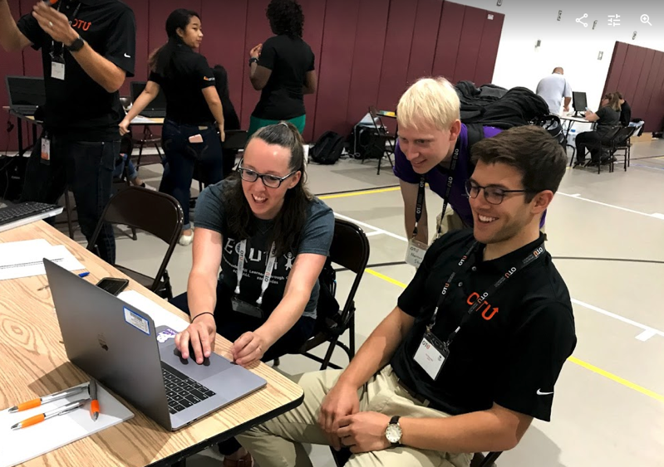
AI Racing League Launch Event, August 6
65 registrants 23 Optum mentors
34 attendees 22 external attendees
(65% of participants)
Notes:
Photo by Mimi Thian on Unsplash
Photo by tribesh kayastha on Unsplash
Photo by Perry Grone on Unsplash

Slide 22
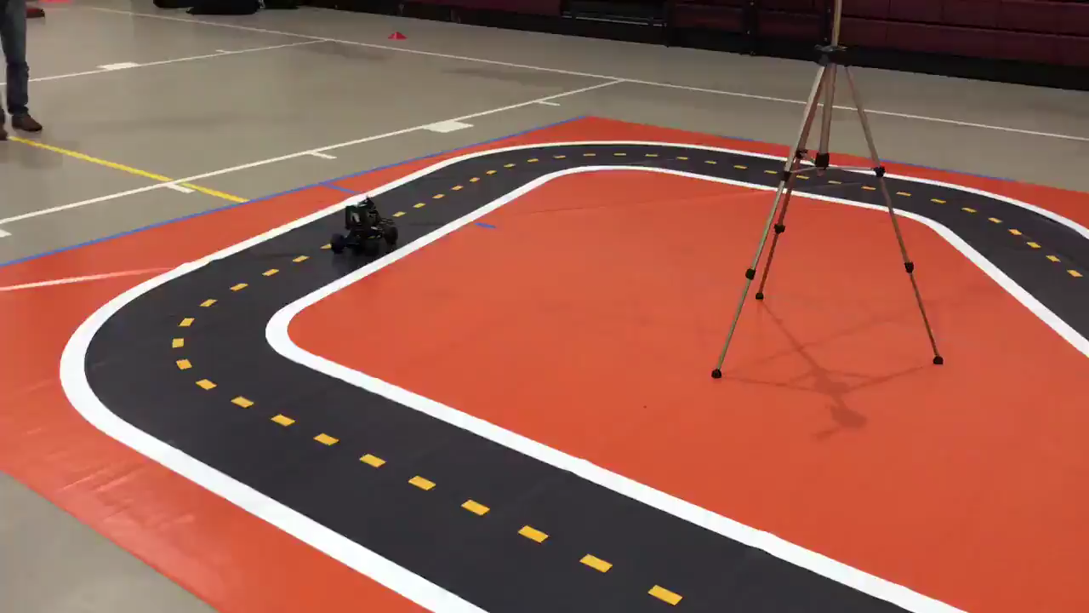
August 2019

Slide 23

AI Racing League Scope and Partners
Collaborators
AI Racing League aims to expose and develop artificial intelligence, robotics, systems engineering, IoT (sensors), 3D printing, and automation based skills for program participants.
Give back – Bridge Optum technical talent with local communities (especially underserved or underrepresented populations)
Create a technical talent pipeline – Build out the future of technical talent
Foster internal cross-team collaboration – Build up Optum Technology culture and reach non-technical colleagues
Enhance technical knowledge – Create exposure to emerging technologies
Initial sponsors/ pilot partners
Notes:
Photo by Mimi Thian on Unsplash
Photo by tribesh kayastha on Unsplash
Photo by Perry Grone on Unsplash

Slide 24
Donkey Car
Roll Cage
Servo Driver
Camera
Raspberry Pi
Brushed Motor
Chassis
Steering Servo
Notes:
https://www.google.com/search?q=donkey+car&source=lnms&tbm=isch&sa=X&ved=0ahUKEwi45-TSrebhAhUQKKwKHcDOCPQQ_AUIDigB&biw=1680&bih=899#imgrc=_gn_fmtYlF3_cM:
https://www.google.com/url?sa=i&source=images&cd=&cad=rja&uact=8&ved=2ahUKEwiur8XasObhAhUMWqwKHeOCCFIQjhx6BAgBEAM&url=https%3A%2F%2Fdocs.aws.amazon.com%2Fdeepracer%2Flatest%2Fdeveloperguide%2Fdeepracer-build-your-track.html&psig=AOvVaw1ZzwYv54ZlfFvEnF_b0j7i&ust=1556114584860504

Slide 25
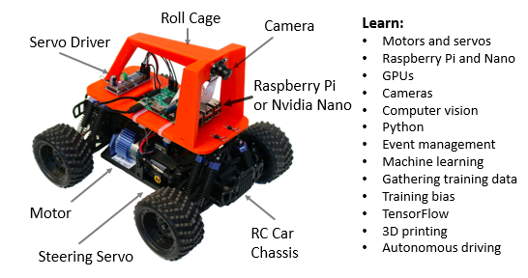
AI Racing League Curriculum
Our platform is inspired by the internationally viral Donkey® Cars movement which uses a Raspberry Pi and camera on a remote-control (RC) car chassis.
Donkey® Cars are low cost cars ($250) that use open source software
Started in California and has grown virally across the world
Users write python code and use deep learning neural networks to train their car to drive itself around a track.
Notes:
Photo by Mimi Thian on Unsplash
Photo by tribesh kayastha on Unsplash
Photo by Perry Grone on Unsplash

Slide 26


AI Racing League Launch Event, Concept Cards
Nvidia Nano
Hardware
Python
Machine Learning
Intermediate Concepts
Starting Concepts
Computer Vision
TensorFlow
Finish!
One double-sided laminated card per concept. Activities and suggested questions on the front. Answers on the back.
Starting Concepts (green borders) have no dependencies on other concepts. They should be attempted first.
Intermediate Concepts (blue borders) should be for students that have completed most of the starting concepts or are already familiar with the topic.
Finishing Concepts (black borders) should be attempted after the intermediate concepts are mastered.
Training a Model
Finishing Concepts
Autonomous
Driving!
Notes:
Photo by Mimi Thian on Unsplash
Photo by tribesh kayastha on Unsplash
Photo by Perry Grone on Unsplash

Slide 27


AI Racing League Launch Event, Feedback
“Open source projects are really about building a community and specifically educating people in Computer Science, Robotics and Machine Learning. It is rare to find an organization whose mission is so aligned with ours. We hope to build a lasting partnership with Optum.” - Adam Conway, Donkey® Cars Co-Founder
“I was so impressed! I look forward to more opportunities to learn about your incredible program!” - Andrea Touhey, Educator | Founder, MathTreks
“It was an amazing experience how all these technologies were put together. Job well done.” - Mohamed Hassan, Big Data Engineer, Thomson Reuters
Notes:
Photo by Mimi Thian on Unsplash
Photo by tribesh kayastha on Unsplash
Photo by Perry Grone on Unsplash

Slide 28
DIY Robotics Builds Community

Slide 29
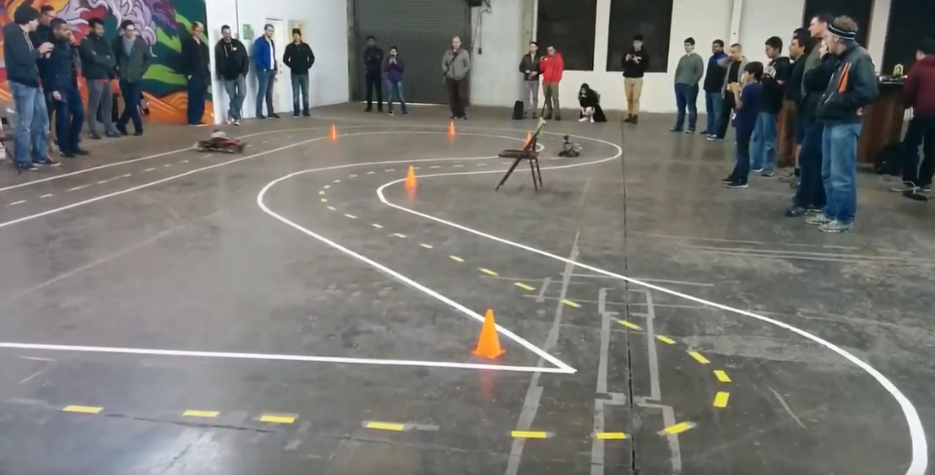
Community Building
2,500 in Bay Area Meetup

Slide 30
Concept Cards

Slide 31
For each student, intelligent agents for teaching must know…
what concepts you already know, what concepts you are not ready to learn,
what concepts you are ready to learn

Slide 32
Concept Space
Content Space
Book
Algebra
Wikipedia
Page
Calculus
Video
Sample Labs
Trigonometry
Mentors
Other Students

Slide 33
Known Concepts
Ready to Learn Concepts
Zone of
Learning
Unknown Concepts
Knowledge Spaces: A Graph of Concepts

Slide 34
Summary
CoderDojo is a flexible program for getting students exposed to STEM concepts
CoderDojo chapters are limited by the numbers of volunteers you can recruit
Many options for low-cost robots
Have concept cards for your curriculum
DonkeyCar’s will be a new option
New options for AI Racing will be common in a few years

